Slide 1
SS ZG653 (RL1.2): Software Architecture A Brief History of Software Architecture
Instructor: Prof. SantonuSarkar

Slide 2
Informally what is meant by (Software) Architecture
Essentially a blueprint of a software system that helps stakeholders to understand how the system would be once it is implemented
What’s should be there in this blueprint?
A description at a higher level of abstraction than objects and lines of codes
So that
Stakeholders understand and reason about without getting lost into a sea of details

Slide 3
Who are Stakeholders?
A complex software has multiple stakeholders who expect certain features of the software
Stakeholder | Area of Concern
Chief Technologist | Does it adhere to organization standards ?
Database Designer | What information to be stored, where, how, access mechanism??? Information security issues?
Application Development team | How do I implement a complex scenario? How should I organize my code? How do I plan for division of work?
Users/Customers | Does it perform as per my requirement? What about the cost/budget? Scalability, performance and reliability of the system? How easy it is to use? Is it always available?
Infrastructure Manager | Performance and scalability Idea of system & network usage Indication of hardware and software cost, scalability, deployment location Safety and security consideration Is it fault tolerant-crash recovery & backup
Release & Configuration Manager | Build strategy Code management, version control, code organization
System Maintainer | How do I replace of a subsystem with minimal impact ? How fast can I diagnosis of faults and failures and how quickly I can recover?

Slide 4
Why Architecture needs to be described?
Each stakeholder has his own interpretation of the systems
Sometimes no understanding at all
Architect is the middleman who co-ordinates with these stakeholders
How will everyone be convinced that his expectations from the system will be satisfied?
Even when the architect has created the solution blueprint, how does she handover the solution to the developers?
How do the developers build and ensure critical aspects of the system?
Misunderstanding leads to incorrect implementation
Leads to 10 times more effort to fix at a later stage
Any Large Software Corporation
Hundreds of concurrent projects being executed
10-100 team size
Projects capture requirements, there are architects, and large Development teams
Architect start with requirements team & handover to Development teams
Notes:
1. Adopting standard architecture process across the organization
Need for standard approach - each project follows its own approach
Need for standard vocabulary- aspects of architecture are interpreted differently
Need for managing risks at early stage- risks are often discovered during implementation
Need for standard architecture outputs- outputs vary from project to project
2. Streamlining work assignments for multiple teams
Need to avoid loss of information in handoffs to implementation teams
Need for implementation teams to understand and comply with architecture principles, design decisions (traceability)
3. Strengthening architecture areas
Need for consistent methods to address some areas such as availability, maintainability and integration
4. Improving productivity through tool and automation
Need for formal language to capture the architecture through tool
Need Architecture analysis to make sure that the design approach will yield an acceptable system
Need reference architecture, patterns, architecture styles for reusability, architecture refinement
Need automated design translation- from architecture to the code

Slide 5
Software Architecture Definition
No unique definition though similar…
(look at http://www.sei.cmu.edu/architecture/start/glossary/classicdefs.cfm )
.. “structure or structures of the system, which comprise software elements, the externally visible properties of those elements, and the relationships among them” (Bass, Clements and Kazman, Software Architecture in Practice, 2nd edition)
“description of elements from which systems are built, interactions among those elements, patterns that guide their composition, and constraints on these patterns. In general, a particular system is defined in terms of a collection of components and interactions among these components” Shaw and Garlan “Software Architecture: Perspectives on an Emerging Disciplines”
“description of the subsystems and components of a software system and the relationship between them. Subsystems and components are typically specified in different views to show the relevant functional and nonfunctional properties of a software system” F. Buschmann et al, Pattern Oriented Software Architecture

Slide 6
Is this Architecture
Viewer
Composer
What we understand
The system has 5 elements
They are interconnected
One is on the top of another
Protocol Engine
Storage
Utility Functions
Typically we describe architecture as a collection of diagrams like this

Slide 7
What’s Ambiguous?
Visible responsibilities
What do they do?
How does their function relate to the system
How have these elements been derived, is there any overlap?
Are these processes, or programs
How do they interact when the software executes
Are they distributed?
How are they deployed on a hardware
What information does the system process?

Slide 8
What’s Ambiguous?
Significance of connections
Signify control or data, invoke each other, synchronization
Mechanism of communications
Significance of layout
Does level shown signify anything
Was the type of drawing due to space constraint

Slide 9
What should Architecture description have?
A structure describing
Modules
Services offered by each module
and their interactions- to achieve the functionality
Information/data modeling
Achieving quality attributes
Processes and tasks that execute the software
Deployment onto hardware
Development plan

Slide 10
What should Architecture description have?......
A behavioral description
describing how the structural elements execute “important” and “critical” scenarios
E.g. how does the system authenticates a mobile user
How does the system processes 1 TB of data in a day
How does it stream video uninterruptedly during peak load
These scenarios are mainly to implement various quality attributes

Slide 11
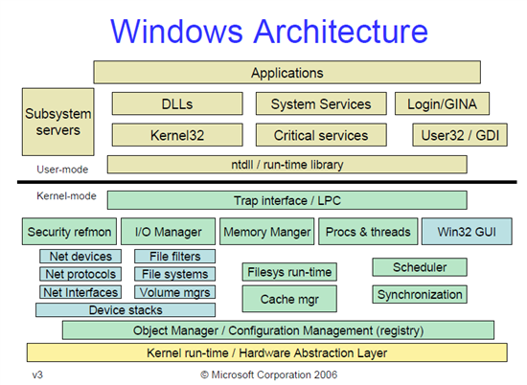
Architecture of Windows https://http://blogs.msdn.com/b/hanybarakat/archive/2007/02/25/deeper-into-windows-architecture.aspx

Slide 12
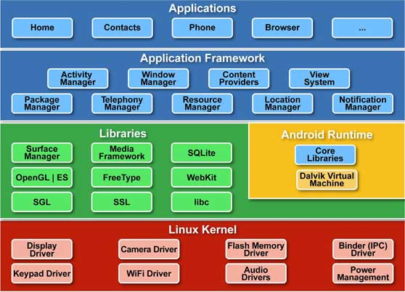
Architecture of Android http://www.techotopia.com/index.php/An_Overview_of_the_Android_Architecture

